Slide 1
463.0 Course Plan
Computer Security II
CS463/ECE424
University of Illinois

Slide 2
Studying Security at
The University of Illinois
CS461/ECE422 Computer Security I
  Fall and Spring
CS460 Security Lab
  Spring
CS463/ECE424 Computer Security II
  Fall and Spring
CS563/ECE524 Advanced Computer Security
  Fall
Cryptography
  Fall or Spring
See https://iti.illinois.edu/education/course-roadmaps for links and updates
This Course!

Slide 3
Summary
This is a course for graduate students and advanced undergraduates and wanting to develop greater depth and breadth in security.
It assumes a basic knowledge of the area such as the material covered by Computer Security I.
This semester it will expect ability to program in Java and C or C++.

Slide 4
Administration
Professor: Carl A. Gunter (cgunter@Illinois.edu)
  Office hour: 1:30PM on Tuesdays in SC4304
Teaching assistant: Allyson Kaminsky (alk2@Illinois.edu)
  Office hours: 5PM on Mondays and 10AM on Thursdays in SC4309
Resource links
  Piazza: https://piazza.com/class/jqr34neym2b1vk
  Repository in U of I Box (contains class slides and assignments): https://uofi.box.com/s/orml8jmfz4absaxmm109co7mkwp1hiom
  Syllabus in Google Apps @ Illinois: https://docs.google.com/spreadsheets/d/16p3my4fDb1FTGJUR3GJnehW7b_2vUJ94gqUchv_eBEg/edit?usp=sharing

Slide 5
Class Format
About 50-60 minutes of presentation
About 15-25 minutes of Q&A discussion
Follow-up online self-test is released at the end of class and must be completed in 24 hours to get credit
  Starting with lecture today
  Sign up for a Moodle account here: https://seclab-minneapolis.cs.illinois.edu/moodle/login/index.php
  Contact TA if you have trouble signing up

Slide 6
Common Assessment
Assessment Element | % of Grade
MP1 | 6
MP2 | 7
MP3 | 8
Midterm | 15
MP4 | 9
MP5 | 10
Participation | 15
Final | 30
This will be used for 100% of the grade for 3 credit students and 75% of the grade for 4 credit students.

Slide 7
Participation
How it Works
Example Question
Measured by participation in class discussion and use of the online self-tests
Generally starts with discussion questions for a few randomly selected students each class.
Notify instructor or TA in advance if you cannot make it to class.
If vendors and users can't keep firmware of routers updated enough to avoid vulnerabilities that are 10 years old, how well will they do with the Internet of Things (IoT)?

Slide 8
MPs
Five assignments, starting today…
MP1 is individual effort only.
Other MPs allow teams of up to three.
You may request a modified, extended, or substituted MP5 if your team wishes.
  Requires proposal and approval in advance
Present MP5 results orally on April 29, April 30, or May 1.

Slide 9
In-Class Exams
Midterm
Final
Takes place 11AM to noon on Tuesday March 5
  In SC1105 (our usual room)
It will ask questions about the first 14 lectures.
It will test
  Attentiveness and recollection
  Reasoning ability in subject matter
Takes place 8-11AM on Wednesday, May 8
  Location to be announced
It will ask questions about all lectures.
  25% from first half
  75% from second half
It will test
  Attentiveness and recollection
  Reasoning ability in subject matter

Slide 10
Exam Attendance
Do not take this class if you are not sure you can attend the exams in person on campus at the times given.

Slide 11
Students Getting 4 Credits
Write a Survey Paper
Steps
Four-credit students are expected to complete a survey paper.
Grade will come 75% from common assessment and 25% from the Extra Credit Assessment
Choose your topic (related to security and privacy).
Select at least 10 papers on the topic.
Proposal due on Tuesday March 12 at 11:59PM
Write an 8 page survey of the papers.
Survey due on Sunday May 5 at 11:59PM

Slide 12
Survey Paper Assessment
Topic (10%): cohesive, not too broad or narrow, important and interesting
References (15%): on-topic papers showing good coverage
Discussion and organization of ideas from topic (40%)
Critique and future challenges (10%)
Writing (25%): correct English grammar and spelling, good organization

Slide 13
Topics from CS461/ECE422
Mindset and ethics
Basic cryptography
Web and TLS
Networking
Control flow
Malware, worms, botnets
Passwords
Forensics, physical security
Policies and information flow
Anonymity and dark web

Slide 14
What More is There to Know?
Revise and extend past topics
Much more to say in key areas
  Privacy
  Data science
  Advertising
  Domain-specific security
  Theory
  Smart phones and their app stores
  And more

Slide 15
Tentative Course Syllabus
Google sheets link

Slide 16
Reading: Tertiary Materials
General textbooks:
  [StallingsB08] Computer Security Principles and Practice, William Stallings and Lawrie Brown. Pearson Education 2008.
  [Bishop03] Computer Security Art and Science, Matt Bishop. Pearson Education 2003.
Surveys and specialized texts. Examples:
  [MirkovicR04] A Taxonomy of DDoS Attacks and DDoS Defense Mechanisms, Jelena Mirkovic and Peter Reiher. Computer Communications Review, Vol. 34, No. 2, April 2004.
  [ThermosT08] Securing VoIP Networks: Threats, Vulnerabilities, and Countermeasures, Peter Thermos, and Ari Takanen. Pearson Education 2008.

Slide 17
Reading: Secondary and Primary Materials
References to scientific research papers (secondary materials) on slides and at the end of the slide set. Example:
  [ParkL01] On the effectiveness of route-based packet filtering for distributed DoS attack prevention in power-law internets, Kihong Park and Heejo Lee. SIGCOMM 2001.
References to standards and source data (primary materials). Examples:
  [FergusonS00] Network Ingress Filtering: Defeating Denial of Service Attacks which employ IP Source Address Spoofing, P. Ferguson and D. Senie. IETF RFC 2827, 2000.
  CERT Advisory CA-1998-01, Incident Note IN-2000-04.

Slide 18
Reading: Slides
Most slides are derived from existing slide sets. Most of these are, in turn, derived from secondary, primary, and other tertiary materials.
Credits to the folks who created the slides from such sources or originated them appear in the notes for the slides.
Example:
  Based on slides by Nikita Borisov and Carl A. Gunter.
  Based on slides by Lawrie Brown.

Slide 19
MP1
Inference in Location-Based Social Networks
You are given:
  Real anonymized datasets
  Users may or may not share their home location
Your task:
  Infer private home locations using friendship information
Due date: by 11:59PM on Monday, January 28.

Slide 20
MP1: Overview
Code skeleton is provided
Checkpoint 1:
  Get familiar with Java
  Read and parse the dataset
Checkpoint 2:
  Implement simple inference algorithm
  Implement your own inference algorithm
Report: one-page, two questions
Ranking

Slide 21
MP1: Datasets
Dataset 1:
  Friendship information
  Home locations for all users
Dataset 2:
  Same format as dataset 1
  No ground truth

Slide 22
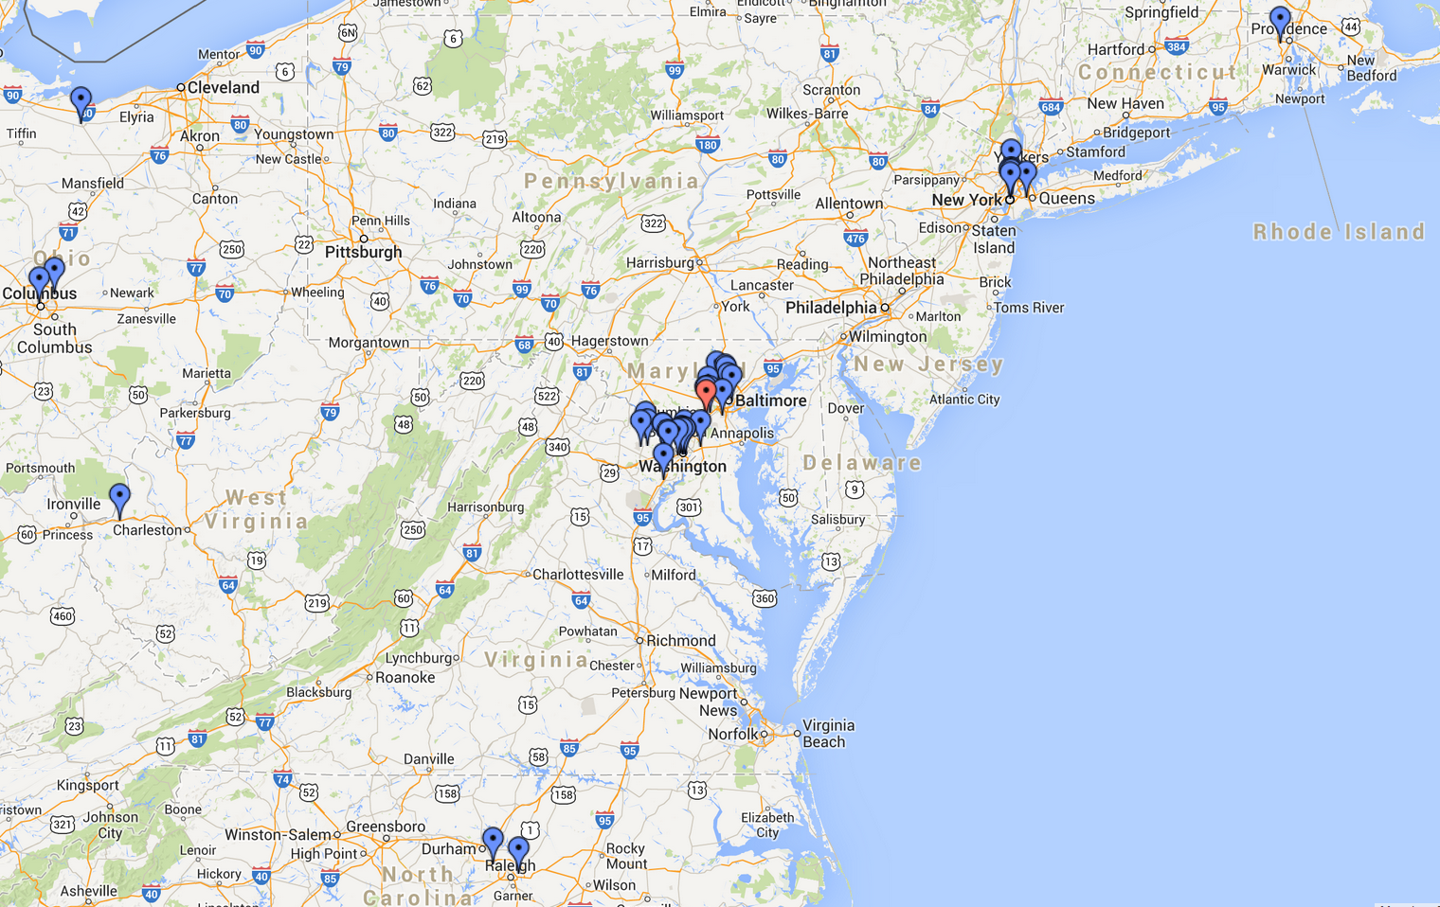
MP1: Visualization
Visualization class ‘Visualizer.java’ is provided

Slide 23
MP1: Keep in mind
Individual effort only
Implementation in Java
Submission:
  Submission instructions to be announced
  Platform:
    Your code must compile and run on EWS
    You can modify ‘compile.sh’ and ‘run.sh’
Automated tests

